Slide 1
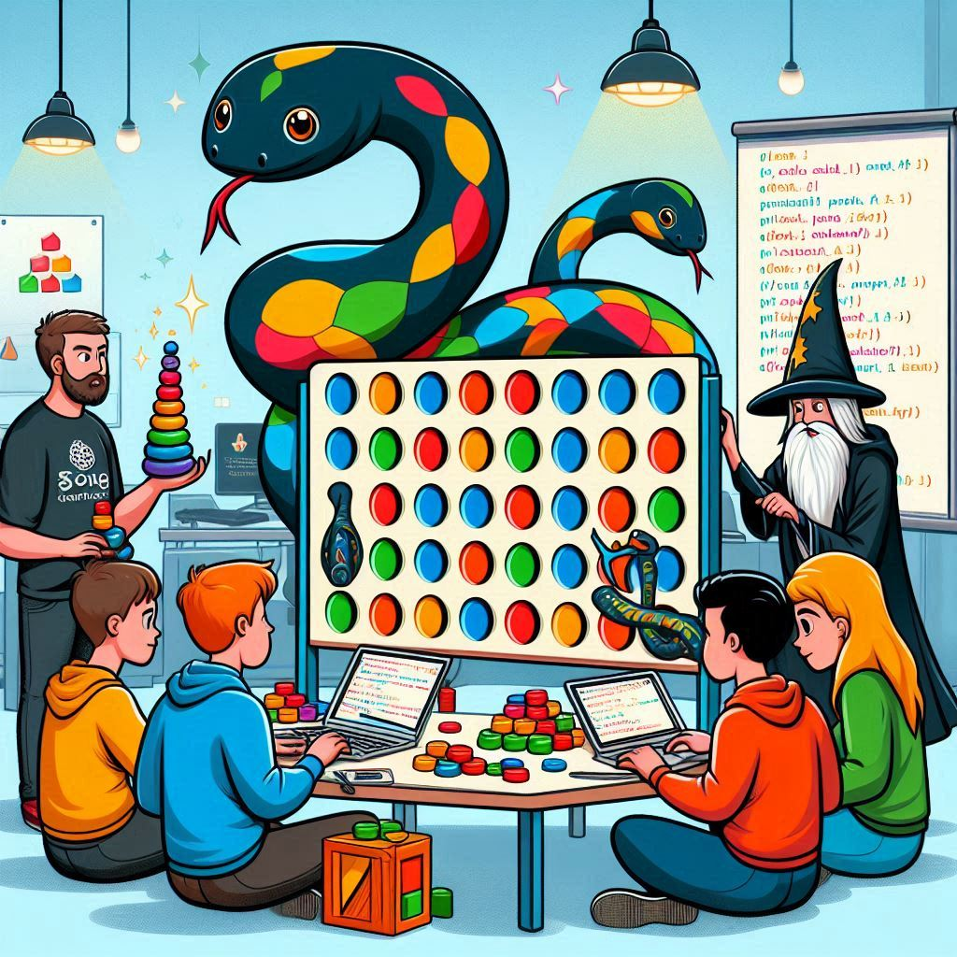
Event Sourcing From The Ground Up
Ravi Selker & Sebastiaan Zeeff
EuroPython 2024

Slide 2




Ravi Selker
Sopra Steria / Ordina Pythoneers
Co-Founder Jamovi
Sebastiaan Zeeff
Sopra Steria / Ordina Pythoneers

Slide 3
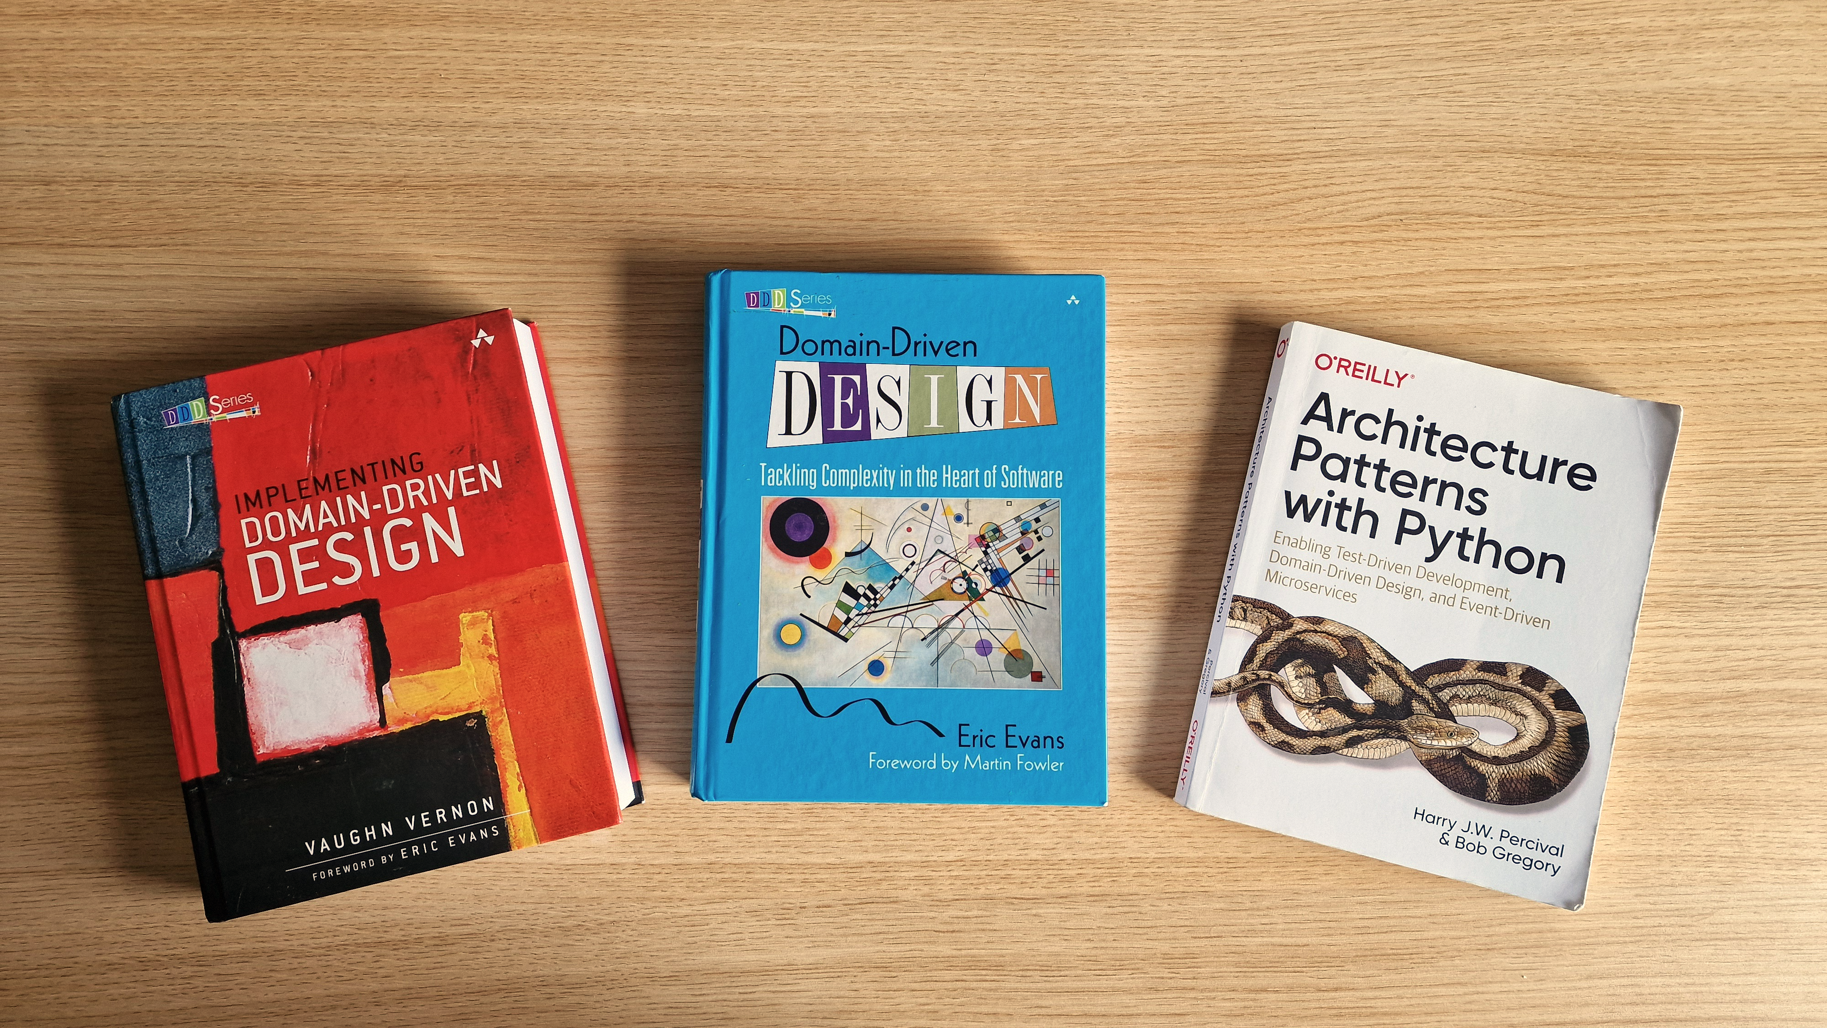
Domain-Driven Design

Slide 4
Domain Model
1
2
3
4
5
6
7
8
9
10
11
@attrs.define class Order: id: OrderId order_lines: list[LineItem] def add_order_line(self, sku: str, price: float, quantity: int) -> None: line_item = LineItem(sku=sku, price=price, quantity=quantity) self.order_lines.append(line_item) def remove_order_line(self, item_id: str) -> None: ...

Slide 5

Events & State
Order Placed
Add Item
To Shopping Cart
Item Added
Place Order
Must have sufficient credit
Customer
Customer
Order Rejected

Slide 6

From The Ground Up
We’re not going to use packages for the event-sourcing logic
No magic abstractions that hide the principles and techniques
We will use packages for other things
E.g., we will use the EventStoreDB-client for persistence logic
The focus of the tutorial is Event Sourcing
Other parts of the app provide support, but may be (over-)simplified

Slide 7
Time | Duration | Topic
09:30 – 09:45 | 15 min. | Introduction
09:45 – 10:15 | 30 min. | Event Storming (simplified)
10:15 – 10:50 | 35 min. | Exercise 1: Starting The Game
10:50 – 11:00 | 10 min. | Discussion Exercise 1 + Questions
11:00 – Coffee Break (15 min.)
11:15 – 11:50 | 35 min. | Exercise 2: Playing The Game
11:50 – 12:00 | 10 min. | Solution Exercise 2 & Introduction Exercise 3
12:00 – 12:30 | 30 min. | Exercise 3: Persisting The Game
12:30 – 12:45 | 15 min. | Solution Exercise 3 + Closing Discussion

Slide 8

Event Storming
Happy Event Happened
Do Command
Must Satisfy Constraint
Persona
Failure Event Happened

Slide 9
Exercise Repository
URL: https://github.com/Ordina-Group/python-event-sourcing-tutorial
The README contains information about setting up the project
The exercises/ directory contains the exercises
There’s a git branch for each exercise to provide a common starting point
There’s a solution branch for each exercise with an example solution
We kindly ask you to attempt the exercises without looking at our solution… 😅

Slide 10
Exercise 1: Starting The Game
Switch to branch 01-exercise-start-game
Follow the exercise at exercises/exercise-01-start-game.md
We’ll discuss our solution at 10:50
Feel free to ask questions
https://github.com/Ordina-Group/python-event-sourcing-tutorial

Slide 11

Coffee Break until 11:15

Slide 12
Exercise 2: Playing The Game
Switch to branch 02-exercise-play-the-game
Follow the exercise at exercises/exercise-02-play-the-game.md
We’ll discuss our solution at 11:50
Feel free to ask questions
https://github.com/Ordina-Group/python-event-sourcing-tutorial

Slide 13
Exercise 3: Persisting Events
Switch to branch 03-exercise-persisting-the-events
Follow the exercise at exercises/exercise-03-persisting-the-events.md
We’ll discuss our solution at 12:30
Feel free to ask questions
https://github.com/Ordina-Group/python-event-sourcing-tutorial

Slide 14
Closing Discussion
When to use Event Sourcing?
Snapshots
Command Query Responsibility Segregation
Mind Your Concurrency
Event Sourcing Python Package: https://pypi.org/project/eventsourcing/

Slide 15

First Edition
PyCon NL
When?​
October 10th, 2024
Where?
Utrecht, The Netherlands
Call for Proposals?
Closing July 31st
https://pycon-nl.org

Slide 16
Event Sourcing From The Ground Up
Ravi Selker & Sebastiaan Zeeff
EuroPython 2024

